Slide 1
Introduction to Behavioral Patterns (2)
Programming Design Patterns

Slide 2
Design Problem
Given a gumball machine that works in the following way:
  If a user enters a quarter, change the state to “HAS_QUARTER”,
    then allow the user to turn the crank.
    change the state of the machine to GUMBALL_SOLD
    reduce the number of available gumballs, and if the number is 0, then change the state to OUT_OF_GUMBALLS.
  If the user ejects the quarter, change the state of the machine to “NO_QUARTER”
Use the given State diagram
Write code for a Gumball machine that implements the given state diagram
Programming Design Patterns

Slide 3
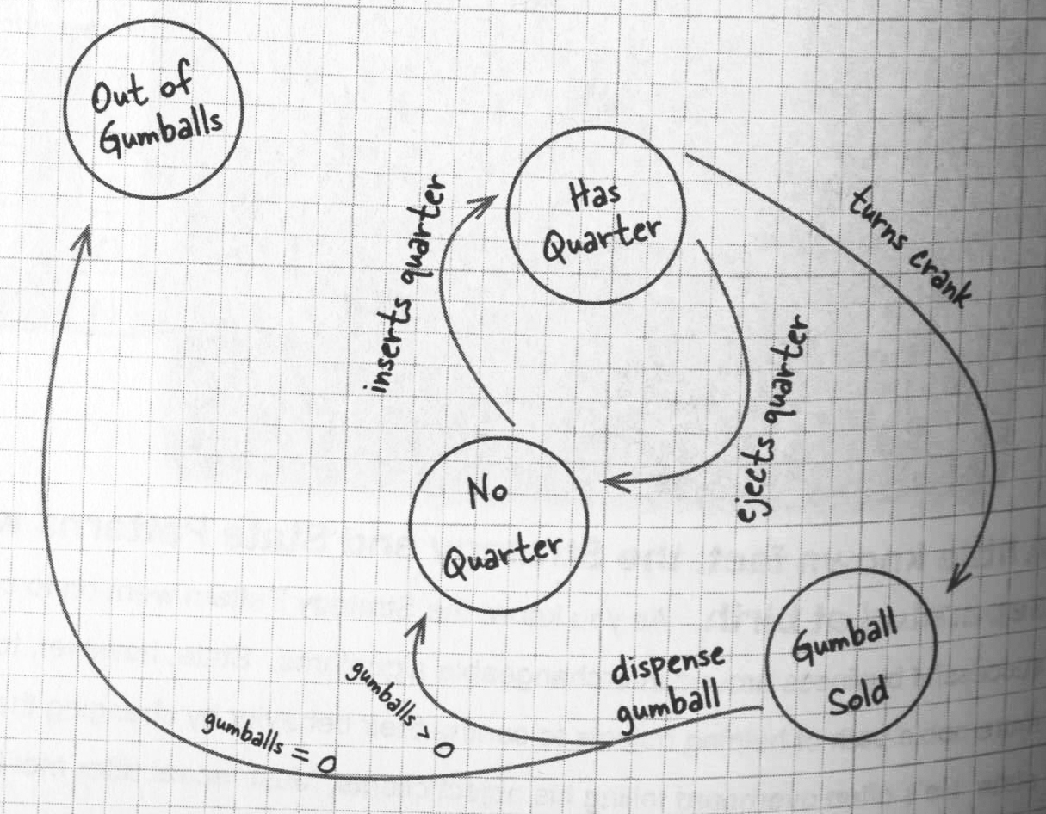
State diagram: Gumball machine
Programming Design Patterns

Slide 4
Coding a State Machine: attempt 1
How many states are available?
  NO_QUARTER, HAS_QUARTER, OUT_OF_GUMBALLS, GUMBALL_SOLD
  In code, these should all be “final static int” variables
Need an instance variable to hold the current state
What are the user actions possible on the machine?
  insert quarter
  turn crank
  eject quarter
  dispense (internal action)
Programming Design Patterns

Slide 5
Coding a State Machine (2)
public class GumballMachine {
final static int SOLD_OUT = 0;
// initialize other states
// initialize number of gumballs
int count = 0;
// initialize the current state
int currentState = SOLD_OUT;
public GumballMachine (int countIn) {
count = countIn;
}
// …
}
Programming Design Patterns

Slide 6
Coding a State Machine (3)
public void insertQuarter() {
if (state == HAS_QUARTER) {
// Classwork:
// add comments, instead of real code, for now
}
// REST OF THE CODE
}
Programming Design Patterns

Slide 7
Coding a State Machine (3)
public void insertQuarter() {
if (state == HAS_QUARTER) {
// can’t insert another quarter
} else if (state == NO_QUARTER) {
// change state to HAS_QUARTER
} else if (state == SOLD_OUT) {
// error, can’t insert as the machine is out of gumballs
} else if (state == SOLD) {
// wait, a gumball is being dispensed
}
}
Programming Design Patterns
Notes:
AWT: abstract windowing toolkit

Slide 8
Coding a State Machine (4)
public void insertQuarter() {
}
public void ejectQuarter() {
}
public void turnCrank() {
}
public void dispense() {
}
// all methods have a similar “structure”
Programming Design Patterns

Slide 9
Coding a State Machine (5)
Now, if a scheme is launched so that once in every 10 uses of the machine 2 gumballs are dispensed.
  Make the necessary changes to the code.
  Evaluate your design
Programming Design Patterns

Slide 10
Coding a State Machine: Design
Follows the open-closed principle?
What varies has been encapsulated?
  encapsulate the change in a different class(es)
Error prone to changes?
Programming Design Patterns

Slide 11
Coding a State Machine: Design
Code isn’t adhering to the open-closed principle
State transitions are buried in the middle of conditional statements
What varies has not been encapsulated
  The Gumball class should not be changed, whenever the logic of each action/state changes
  encapsulate the change in a different class(es)
Error prone to changes
Programming Design Patterns
Notes:
AWT: abstract windowing toolkit

Slide 12
Designing a State Machine
Define an interface with a method for each action
Implement a State class for every state of the machine
  these classes are responsible for actions in that state.
Get rid of conditional code
  delegate it to the state classes. i.e. delegate the actions to the respective State classes
  use an instance variable to keep track of the current state
Programming Design Patterns
Notes:
AWT: abstract windowing toolkit

Slide 13
State Pattern: Gumball Machine
Apply the State pattern to the state machine shown in the diagram
  page 386
Programming Design Patterns
Notes:
New code needs to be added to the Gumball class to instantiate the new State. Then, just add the new classes for the State.

Slide 14
State Interface
public interface State {
public void insertQuarter();
public void ejectQuarter();
public void turnCrank();
public void dispense();
}
Programming Design Patterns

Slide 15
State Pattern: Context Class
public class GumballMachine {
// declare all States, count of gumballs, currentState
// constructor: initialize count, state objects
public void insertQuarter() {
// delegate to the insertQuarter() method of the relevant state
}
public void ejectQuarter() {
// delegate
}
…
}
// Ok for the Gumball machine itself to implement the State interface
Programming Design Patterns

Slide 16
State Pattern: Context Class
public class GumballMachine {
State soldOutState, noQuarterState, …;
State currentState = …;
int count = 0;
public GumballMachine(int noOfGumballs) {
if (count > 0) {// change state }
// initialize all the State objects
// pass a reference to “this” to the State objects
}
public void insertQuarter() { currentState.insertQuarter(); }
public void ejectQuarter() { currentState.ejectQuarter();}
…
}
Programming Design Patterns

Slide 17
State Class Implementation
public class HasQuarterState implements State {
// Classwork:
// constructor: take the gumball machine
// for each method of the interface,
// implement the method (just add comments for now)
}
Programming Design Patterns

Slide 18
State Class Implementation
public class HasQuarterState implements State {
// constructor: take the gumball machine
public void insertQuarter() {
// error message, can’t insert another quarter
}
public void ejectQuarter() {
// change state of the machine.
// use the reference to Gumball context class
// passed in the constructor
}
public void turnCrank() {…}
public void dispense() {…}
}
Programming Design Patterns

Slide 19
State Pattern: Open to extension?
Now assume more states need to be added
  what code needs to be added and where
Programming Design Patterns
Notes:
Add a new state in the Context class, create a new class for the State.

Slide 20
State Pattern: basic idea
Changes the structure of the code (compare with the initial implementation)
  functionality, however, remains exactly the same
Gets rid of error-prone if-statements
  difficult to maintain such code
Each state is closed for modification
  but the Gumball machine is open for extension
Localized the behavior of each state to its own class
Programming Design Patterns
Notes:
New code needs to be added to the Gumball class, and then just to the new classes.

Slide 21
State Pattern: basic
Gumball class is the "context" class that presents a single interface to clients.
Define a State abstract base class or an Interface.
“States" of the state machine are derived classes of the State base class.
Localize state-specific code into respective derived classes.
The Context class has a pointer to "state" classes.
To change the state, the pointer to current-state is changed in the Context class.
Programming Design Patterns
Notes:
New code needs to be added to the Gumball class, and then just to the new classes.

Slide 22
State Pattern: definition
Allows an object to alter its behavior when its internal state changes.
  The object will appear to change its class.
  What does this mean? Homework
Checkout the class diagram for State Pattern
  Homework: page 410
Programming Design Patterns
Notes:
Because of composition, the behavior of the object is changed, and so to the client it appears as if the object was instantiated from some other class.

Slide 23
State Pattern: questions
Should the code for transition between states be placed in the State classes or in the Context class?
  Homework
Should the clients interact with State classes?
  Yes/No: why?
Programming Design Patterns
Notes:
Place it in the Context class, or else there are dependencies between the State classes. Page 412.
No, the clients should interact just with the Context class. The use of State classes should be hidden.

Slide 24
Design Problem (2)
A database gets connections from 3 kinds of users
  developers
  sales
  accounting
Connections from all the 3 categories (listed above) need to perform the following functions:
  open, update, log, close
Design the Database connection control using the State pattern
  Even though State is an incorrect pattern for this problem
Programming Design Patterns

Slide 25
Database Connection Design (1)
What are the States?
  DEVELOPER, SALES, ACCOUNTING
    a class for each one of these
What are the actions?
  open, update, log, close
    these are methods of the interface
Programming Design Patterns

Slide 26
Database Connection Design (2)
What are the States?
  DEVELOPER, SALES, ACCOUNTING
    a class for each one of these
What are the actions?
  open, update, log, close
    these are methods of the interface
Programming Design Patterns

Slide 27
Database Connection Design (3)
public interface State {
public void open();
public void close();
public void update();
public void log();
}
Programming Design Patterns

Slide 28
Database Connection Design (3)
class Developer implements State {
public void open() { ..}
public void close() { …}
public void update() { …}
public void log() { …}
}
class Sales implements State {
public void open() { ..}
public void close() { …}
public void update() { …}
public void log() { …}
}
Programming Design Patterns

Slide 29
Database Connection Design (3)
public class Connection {
State developer, sales, accouting;
public Connection() {
developer = new Developer(this);
// initialize other state objects
}
public void open() {
currentState.open();
}
public void close() {
currentState.close();
}
public void update() { …}
public void log() { …}
}
Programming Design Patterns

Slide 30
Design Problem
Design a light switch functionality
  How many states does it have?
  How many actions are possible?
Now, modify/extend your code for a 3-way switch.
  two locations to control the same light bulb.
Programming Design Patterns
Notes:
Two states: on, off
Two actions: turnOn, turnOff
If you turnOn when the state is off, change the state to On
If you turnOn when the state is on, don’t change the state. Do nothing
Same for turnOff actions.
Should have a light object, which implements an interface Device, that is passed by the Context class to the States

